Slide 1

Office of Research Services
Introduction & Grants Information
Loyola University of Chicago
6439 N Sheridan Road
Granada Center, 4th Floor
Chicago, IL 60660-5309
Phone: 773.508.2471
Email: ors@luc.edu
www.luc.edu/ors

Slide 2
ORS Introduction
Jennifer Rios, Office Manager/Internal Grants
Andrew Ellis, Associate Director of Research Compliance
Angelica Vaca, ORS Director

Slide 3

FINDING FUNDING
Internal Grants administered by ORS
Adding Keywords to your PTAP Profile
PIVOT Database

Slide 4
PTAP
PROPOSAL
TRANSMITTAL
APPROVAL
PROCESS
PTAP is a University document that must be completed online by faculty (or a Research Administrator on behalf of the faculty member) planning to submit a proposal for a research, training or other initiative to an external sponsor.

Slide 5

Why should you select keywords in your PTAP Profile?
When you add keywords to your PTAP User Profile, you will periodically receive external funding opportunities via email that correspond with your research interests (keywords).
The keywords listed in PTAP are the same keywords used in PIVOT (Funding opportunities & expertise database).
If you have no keywords listed in your profile, you may be
missing out on potential funding opportunities…Oh No!!

Slide 6
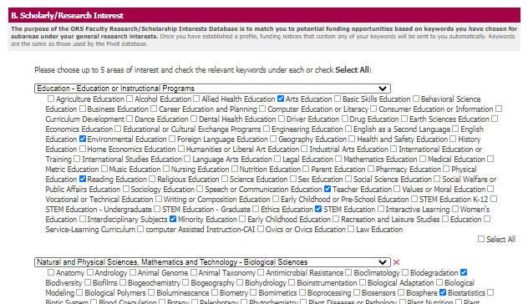
How to add Keywords to your PTAP Profile
Log into www.ptap.luc.edu
Click on “Update Your Profile”
In section B-Scholarly/Research Interest, click “edit”
You may choose up to 5 areas of interest and check the relevant keywords under each area (or select all).
When finished, click “Update”

Slide 7
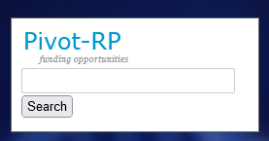
PIVOT Funding Database
pivot.proquest.com
The Pivot database provides access to the most comprehensive global source of funding opportunities. When you create your Pivot profile, you can:
    Sign up to receive customized funding alerts
    Save and return to previous funding searches
    Share funding opportunities directly from Pivot
    Track individual funding opportunities
FREE for
LUC users!
NOTE: The Pivot search box widget is now located on the ORS main page!!
Directions on how to create a PIVOT Profile can be found in the “Faculty” box on the
ORS main page at www.luc.edu/ors

Slide 8

ADDITIONAL FUNDING RESOURCES
You
Can
Do
It!
https://www.grants.gov/web/grants/home.html
https://beta.nsf.gov/funding/opportunities
https://grants.nih.gov/funding/index.htm
https://www.neh.gov/grants/listing?keywords=&page=1
Look at various Agency and Institute website directly.

Slide 9


ORS Internal Grants

Slide 10
Internal Grants Administered by ORS
Research Support Grant (RSG): Similar to seed grants. RSG’s help faculty with securing preliminary data in order to apply for larger external funding. RSG’s are awarded up to $5,000.
Manuscript Publication Assistance (MPA): MPA assists faculty with fees associated with the preparation of scholarly manuscripts or creative artwork for publication or presentation. ORS will cover 50% of the total cost up to $1,000.
Book Subvention: Aids faculty in the costs of publishing scholarly books. Book Subvention grants will cover up to $2,000.
Note: All internal grants awarded are managed by ORS.

Slide 11
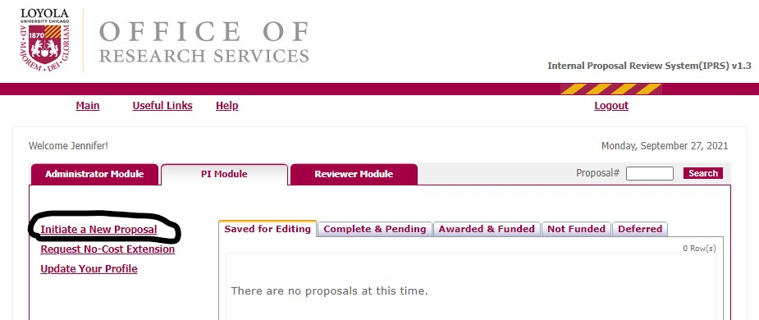
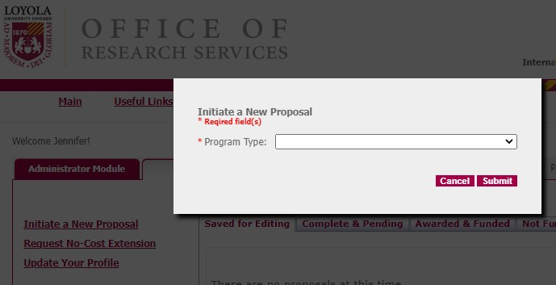
Eligibility & How to Apply
All full time faculty from the Water Tower and Lakeshore Campuses are eligible to apply for ORS Internal Grants.
Login to IPRS at https://iprs.luc.edu
Click “Initiate a New Proposal”
Choose the internal grant you want to apply for
from the drop down list.
Follow the prompts to apply.

Slide 12
ORS Internal Grant Deadlines & ORS Contact Information
Deadlines
ORS Contact Information
Manuscript Publication Assistance (MPA) and Book Subvention Grants have a rolling deadline.
Research Support Grants (RSG) deadlines are August 1st, November 1st, February 1st, and May 1st, unless otherwise noted.
ORS Contact Information:
Office of Research Services (ORS)
6439 N. Sheridan Road
Granada Center, Ste. 400
Phone: 773-508-2471
Email: ors@luc.edu
www.luc.edu/ors

Slide 13
Research Integrity and Compliance
Andrew Ellis
Associate Director of Research Compliance
aellis5@luc.edu

Slide 14
Introduction
Greeting
A branch of ORS dedicated to ensuring compliance with the regulations.
Working with our Institutional Official, Dr. Singh (Vice Provost for Research)

Slide 15
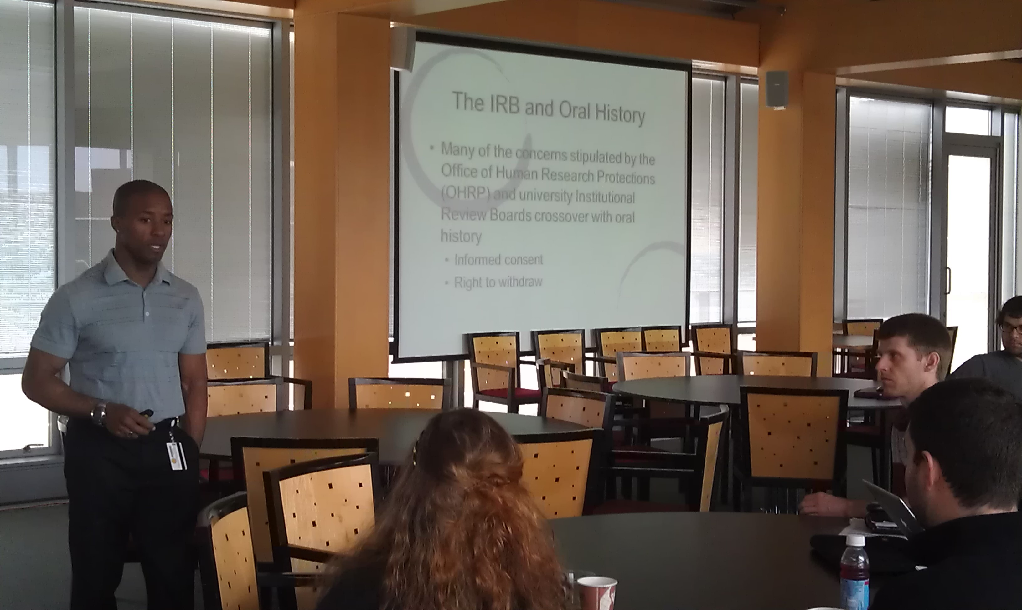
Responsible Conduct of Research and
Scholarship Program
Required “RCR” for people funded by the NSF or NIH.
Required for any graduate student that conducts “research”
  Thesis or Dissertation
UNIV 370
  Two Day program
  Usually scheduled during breaks
  Next session is in January
  Faculty members can register by contacting Andy

Slide 16
Areas of Research Compliance
Human Subject Research
Laboratory Animals (for research or teaching)
Biological and Chemical Hazards
Radiation
Responsible Conduct Training- “RCRS”

Slide 17
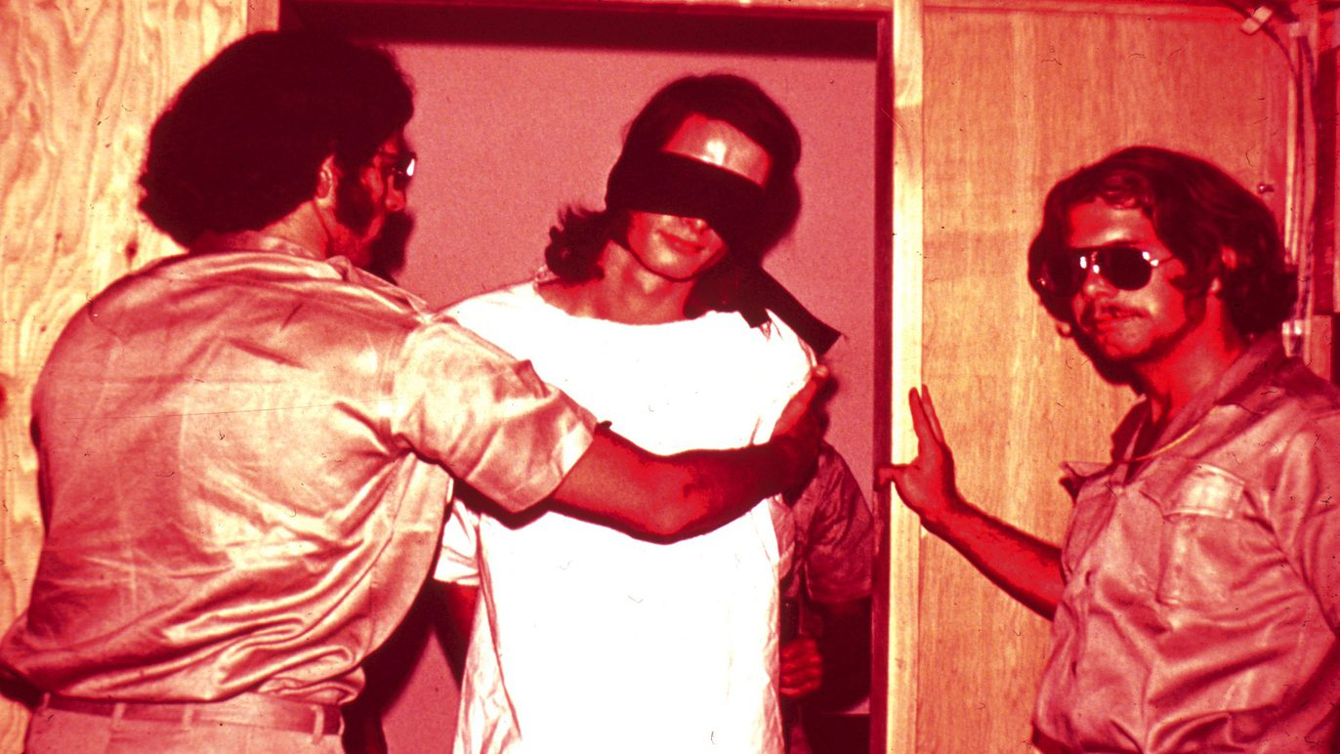
Human Subject Research
Requires oversight of the LUC IRB
Must obtain approval before involving any human subject in research.
Three “levels of review”
  Convened
  Expedited
  Exempt
Training Requirements
  CITI Program
Applications are done online
  CAP system

Slide 18
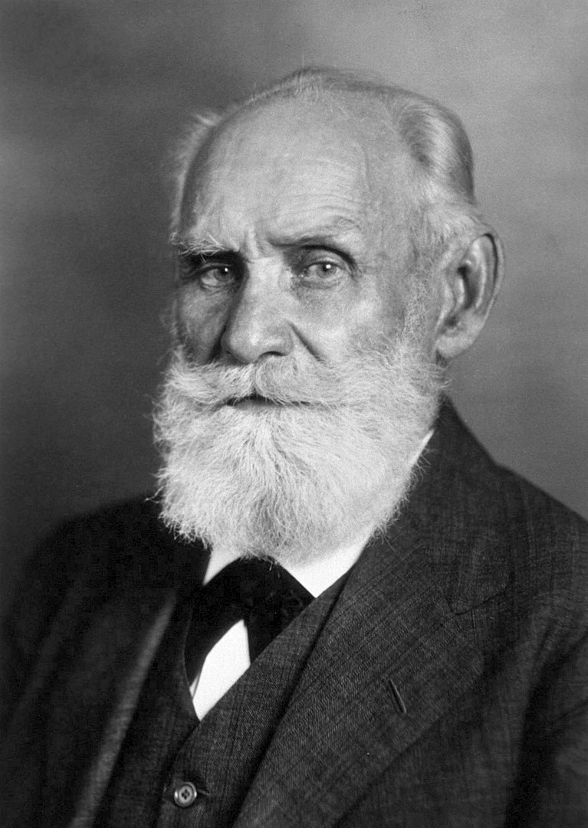
Animal Use In Research & Education
Any use of live vertebrate animals on/off campus needs to have IACUC oversight.
Approval must be obtained in advance.
Research team needs to have completed online training and have a current tetanus inoculation statement with the application.
Most animals are housed in the Animal Care Facility (ACF) in the Quinlan Life Science Building
Should work with the LUC Attending Veterinarian (Dr. Cera)
Applications are done online using the CAP system.

Slide 19

Biosafety
The Institutional Biosafety Committee (IBC)
    Meets about 3 times a year
Biosafety Officer is Dr. Bryan Pickett (Biology Department)
Reports to the National Institutes of Health (NIH) annually
Loyola University Chicago takes very seriously its obligation to oversee research and instruction that involves biohazardous materials and/or recombinant DNA.
Before initiating any work involving biohazardous materials and/or recombinant DNA, whether supported by external funding or not, principal investigators are required to have their protocol approved by the Institutional Biosafety Committee (IBC).
Seek approval before ordering/purchasing/acquiring material

Slide 20

Radiation Safety Program
Radiation Safety Committee
  Meets about 4-6 times a year
Radiation Safety Officer Eli Port (RSSI)
RSSI a safety company that does inspections and surveying, training, and assists with the licensing requirements
Must have approval of the RSC to have or use any radioactive materials
Must report any equipment (produces radiation or laser energy) to Andrew and the RSO
Laser Safety is included (Dr. Stephan Steidl is the LSO)

Slide 21
Tips
Consider the requirements for using human subjects or animals in your research from the start.
Plan your applications in advance (including renewals)
Report any concerns or issues as soon as possible.
Do not hesitate to contact Andy or a compliance assistant for help.

Slide 22
Resources-Contact Information
The ORS web site www.luc.edu/ors
Research Compliance web site
  http://www.luc.edu/ors/compliance.shtml
Contact me anytime
Andrew Ellis
Associate Director of Research Compliance
aellis5@luc.edu
(773) 508-2689

Slide 23

Hmmm, I‘m thinking of submitting a proposal. Where do I start?

Slide 24
Proposal & Budget Preparation
Contact ORS
ORS@luc.edu

Slide 25
Key to a Successful Submission:
Early contact and coordination with your Research Administrator
ORS will need:
RFP –Request for proposal-Sponsor Guidelines
*Do’s
*Don’ts

Slide 26
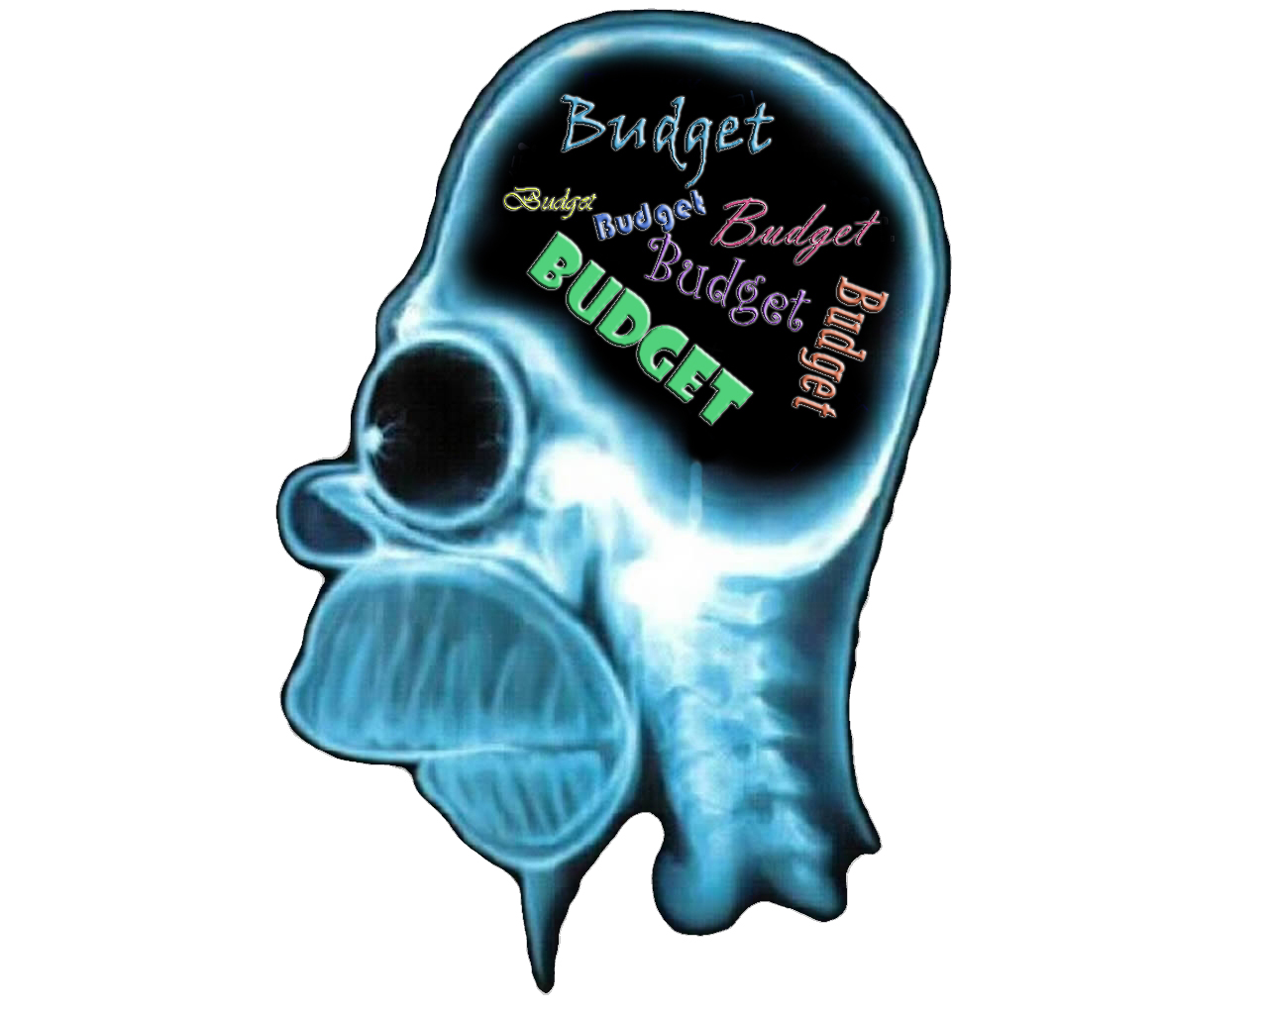
What’s on your mind??

Slide 27
What Makes an Adequate Budget?
Reflects goals
Clear (Narrative)
Realistic
Adheres to guidelines & policies

Slide 28

RULE 1
RULE 2
Develop a Realistic Budget!
Justify Your Needs

Slide 29
What is PTAP?
Proposal Transmittal and Approval Process
https://ptap.luc.edu
*PI completes and submits to ORS-
*Complete and final version ..3 (Three) days prior to deadline
*Institutional Approval
*Houses the story of your Project
*From Sunrise to Sunset of your project
*Programmatic Reporting
*University Officials access to view your submissions

Slide 30

Key Take Away
Contact Early-Contact Often
Jennifer Rios: jrios1@luc.edu
Andrew Ellis: aellis5@luc.edu
Angelica Vaca: avaca1@luc.edu

Slide 31


